Slide 1
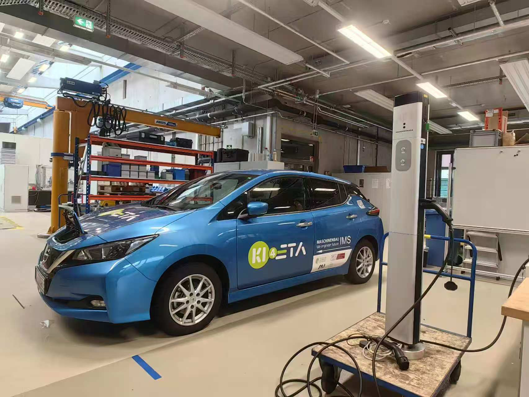
ADP - Charging Station Upgrade to OCPP Communication for Smart Charging
reported by Junfan Jin, Can Zeng, Yunan Jiang and Huang Chen

Slide 2
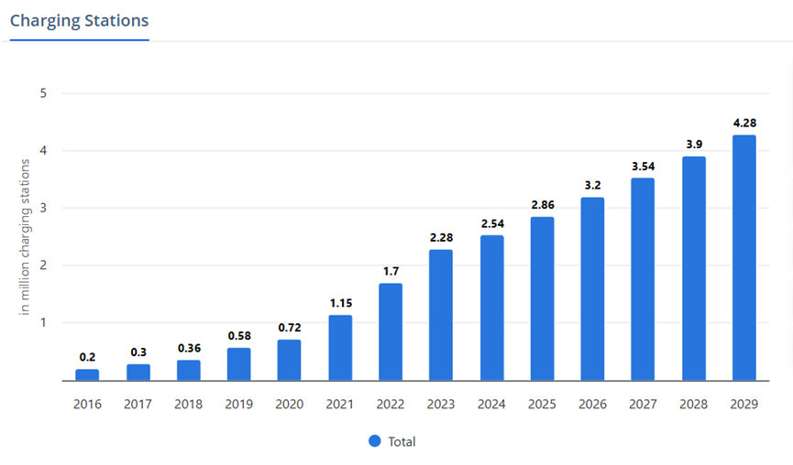
Background
1, Increasing number of
EVs & Charging Stations
2, In Germany, “plug and
charge” mode of 10 million
EVs by 2035 increase 50%
in low-voltage grid and
transformer costs [1]
Figure 1: Charge station sales increasing over the years [2]

Slide 3
Significance
OCPP
Peak shaving
Variable charging rate
Open source
Decrease overload of grid
Electricity price
Battery capacity

Slide 4
Objectives
1, Search and read existing literature on standardized charging infrastructure and smart charging
2, Learn about the existing charge point
3, Upgrade the old charge point
to support the OCPP communication protocol
4, Complete the construction of a prototype of a smart charging system
5, Test and debug the functions of the smart charge point

Slide 5

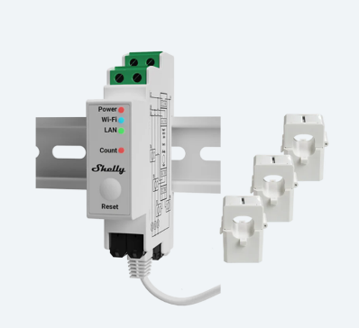
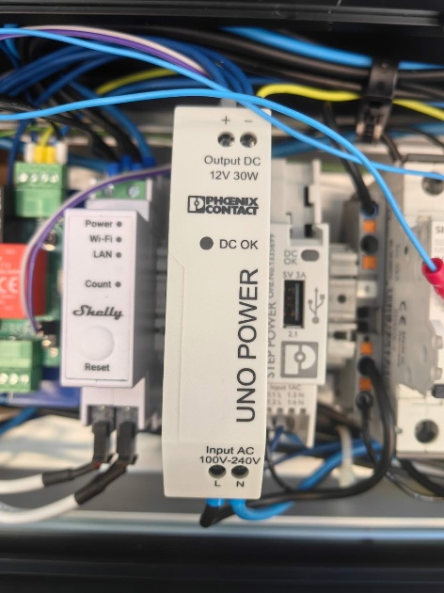
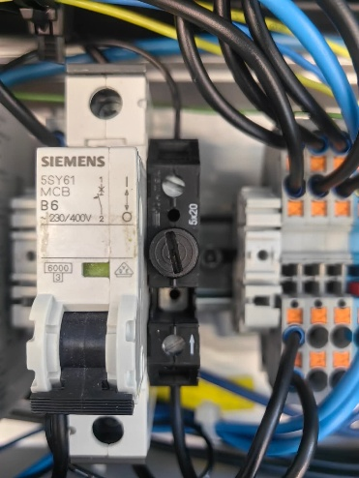
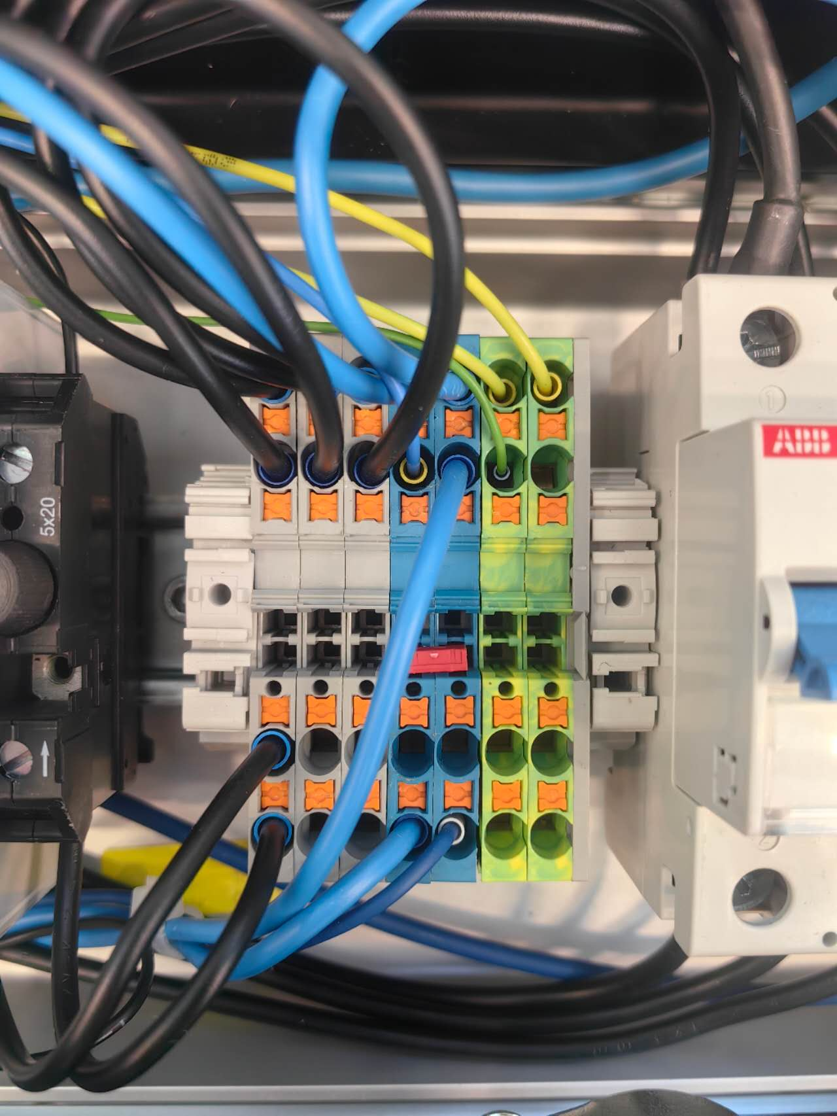
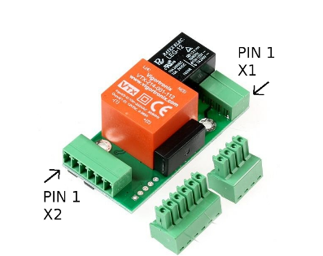
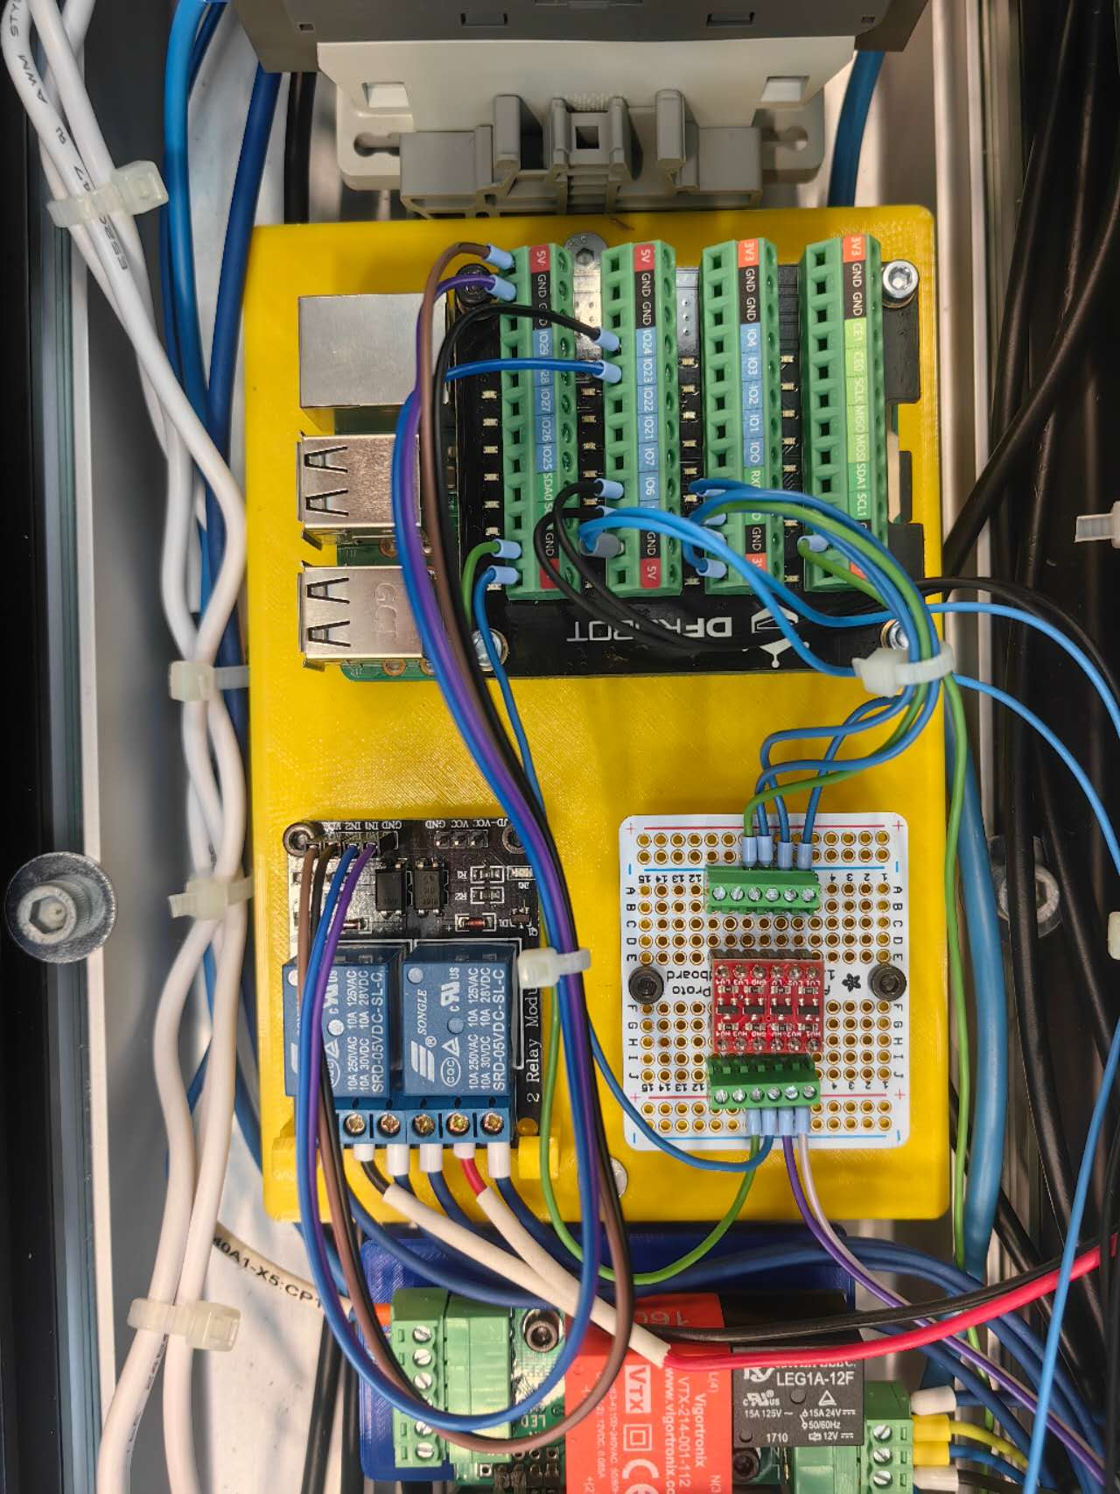
Hardware
Shelly sensor
Power supply, Circuit breaker, Fuse, Wire connector, etc.
EVSE
SmartCharge Board
Auxiliaries
Original charge station
Main functional components
Notes:
Our charging station is mainly composed of these parts

Slide 6
Main functional components
Shelly sensor
Shelly Pro 3EM
3 current clamps measure the 3-phase current: used for Data Visualization.
Record total charged energy: used for the Calibration of the charge plan.
EVSE
Electric Vehicle Supply Equipment
Communicate with EV in the form of PWM signal and voltage level, indicating the maximal allowed current and vehicle state.
Controlled by reading/writing the corresponding registers via Modbus communication
Notes:
The main functional components include a shelly sensor. This sensor can measure the current of the 3-phase power with its clamps and record total charged energy.
EVSE stands for Electric Vehicle Supply Equipment. It is mainly used to set the max current and get the vehicle state.

Slide 7

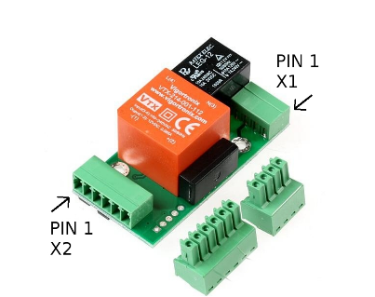
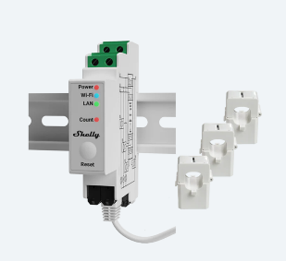
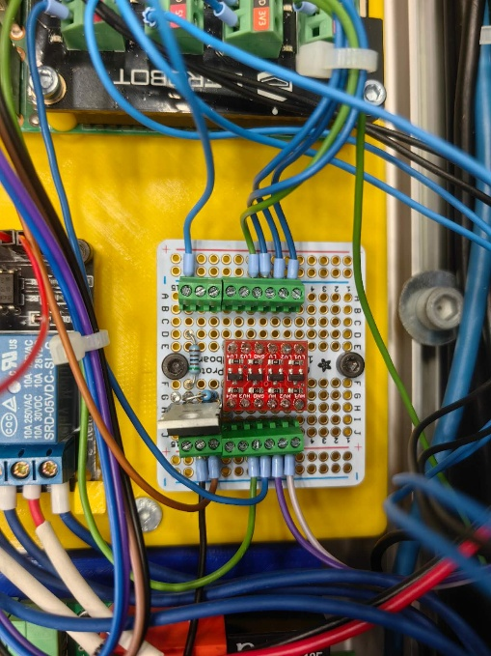
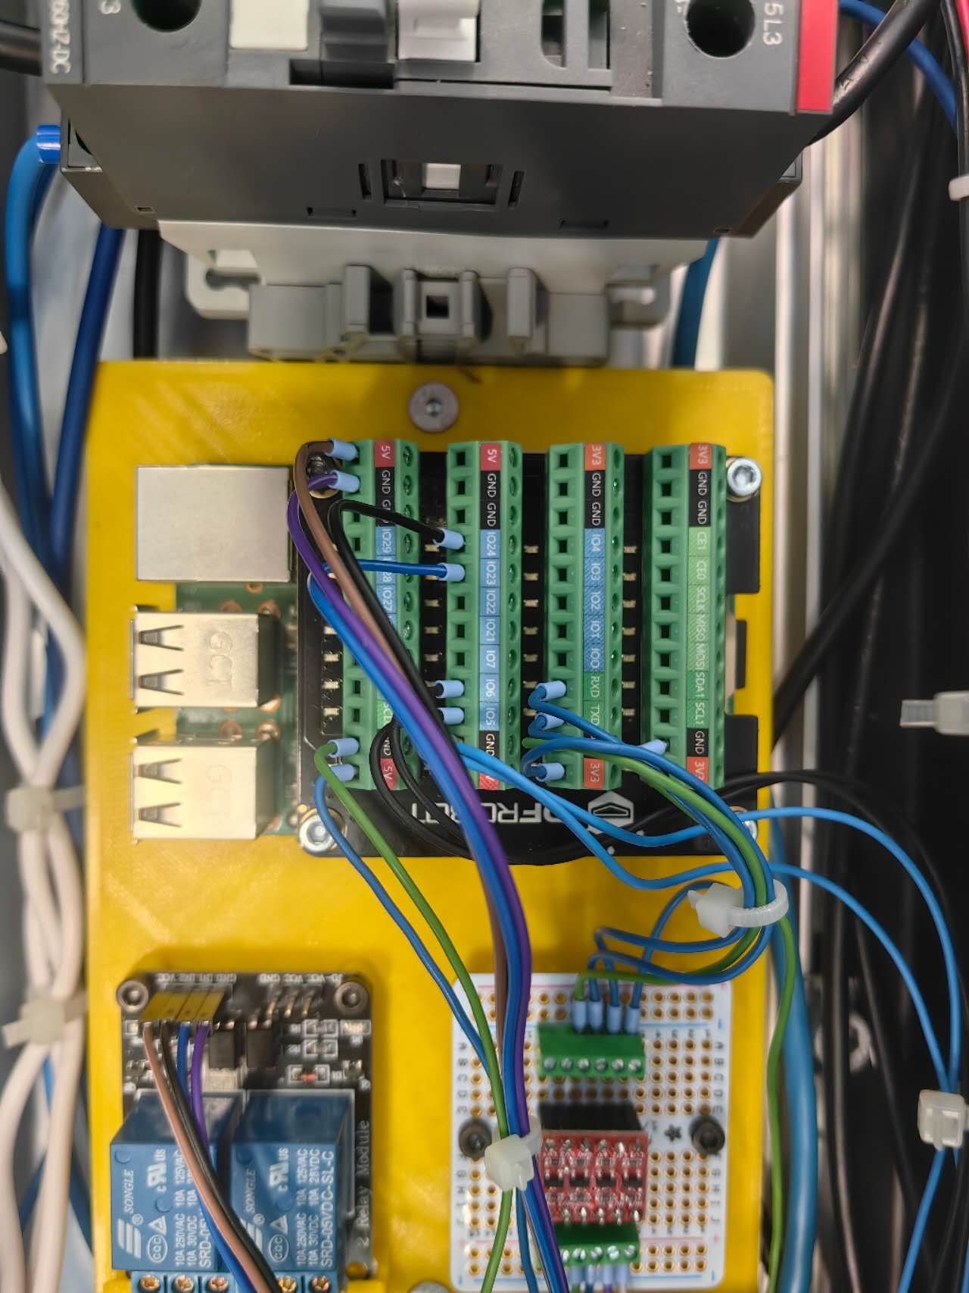

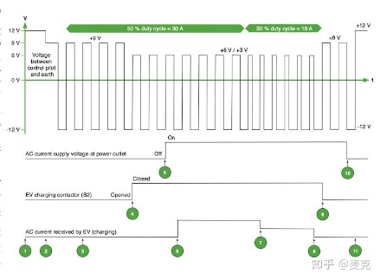

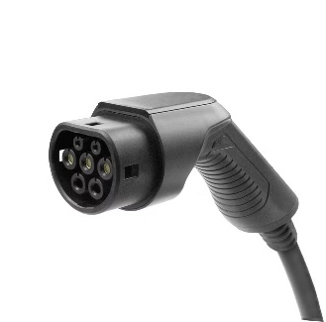
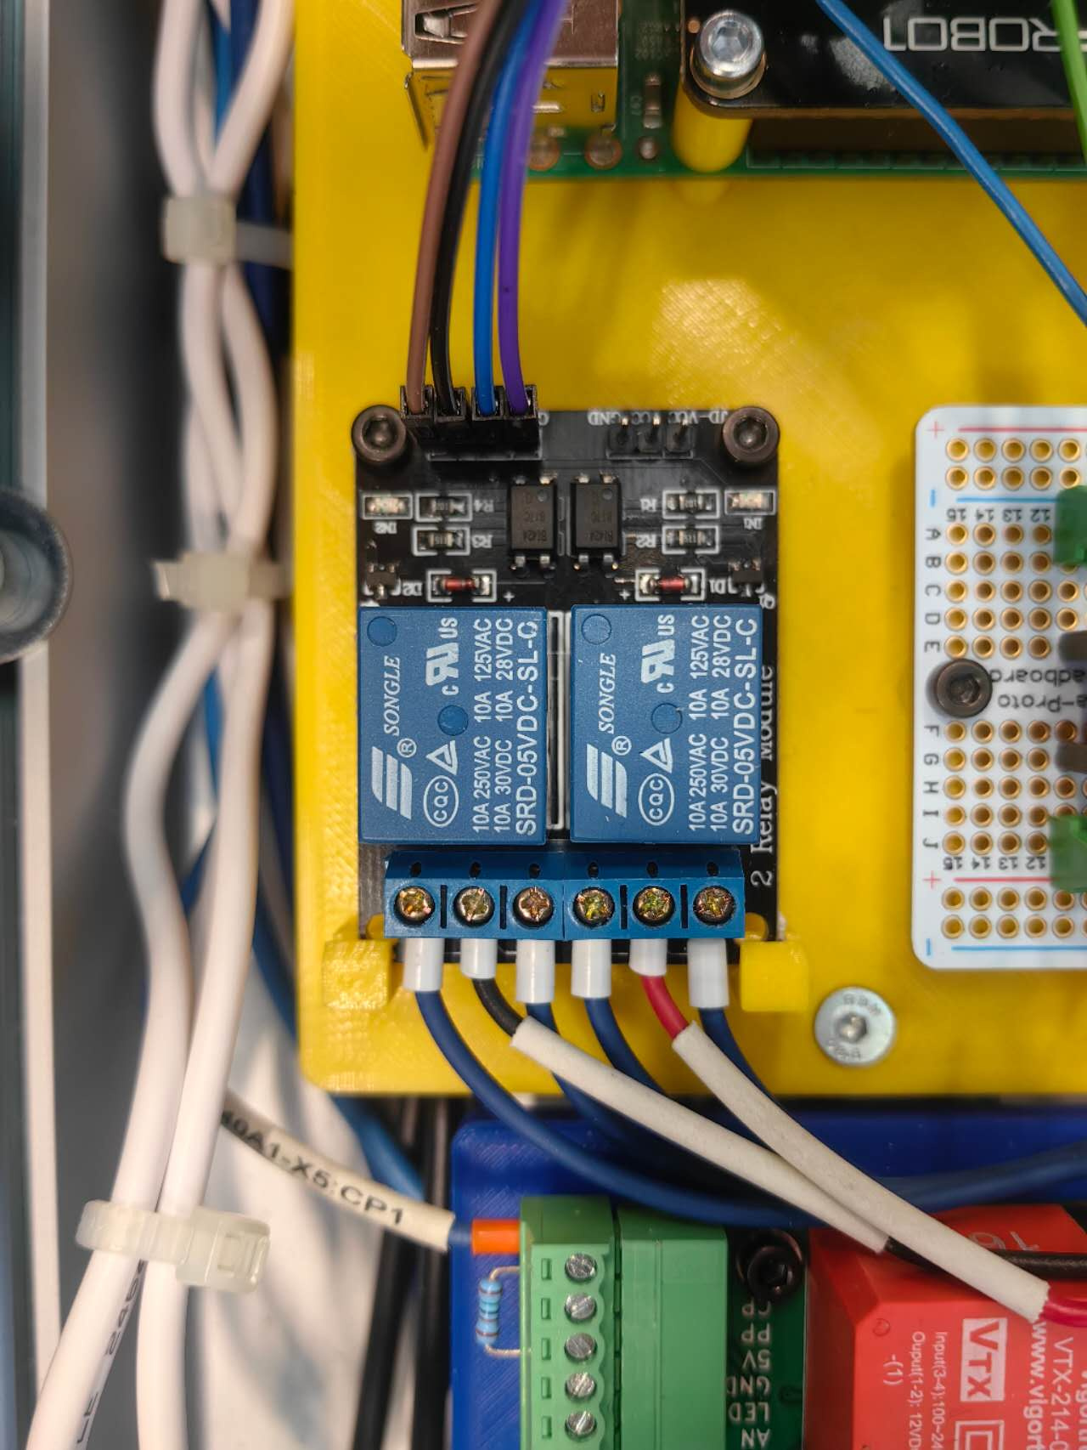
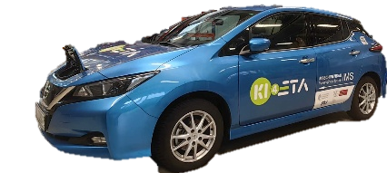
Main functional components
Web port
3.5V
Level shifter
5V
EVSE
TX/RX
RX/TX
Shelly
Raspberry Pi
GPIO
LED
PWM signal
Latch motor
Relay
Notes:
The smart charge board is the most important part. It is a 3D-printed board to mount the components on the charging station.
Raspberry Pi is the carrier of the program. It communicates with different components in various ways.
Shelly， the web port, and Raspberry Pi are connected to the same Wifi and transmit information wirelessly.
The Raspberry Pi communicates with EVSE via serial communication. But the working voltage of these two parts is different. So we add a level-shifter in between to convert the voltage. Otherwise the GPIO pins will be damaged.
The EVSE communicates with the EV using PWM signal. The duty cycle represents the allowed current, and the voltage level represents the vehicle states.
We also utilized the GPIO pins of Raspberry Pi for other purposes like latching the charge plug with motor and relay, controlling the blinking of LED.

Slide 8
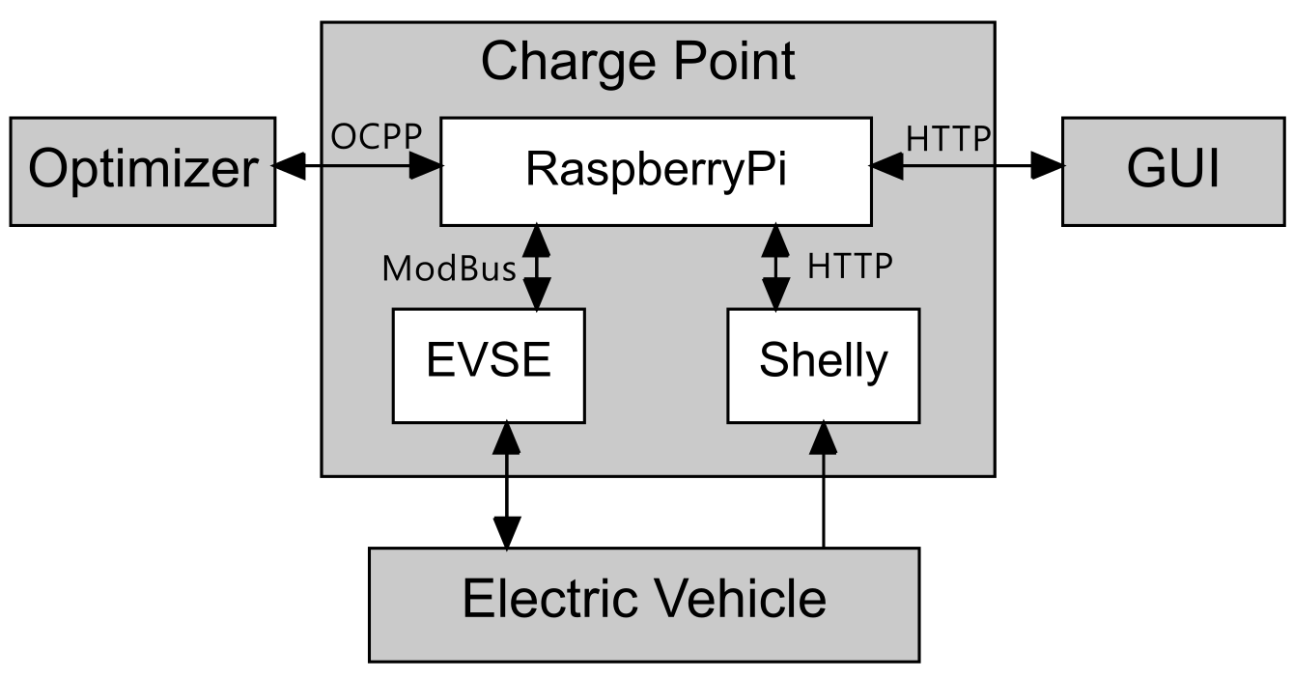
System Architecture Overview
Notes:
So I will introduce the system structure first.
This project has four main parts: the optimizer, the charging station, the vehicle, and the remote GUI control. Inside the charging station, we have the Raspberry Pi controller, the EVSE actuator, and the Shelly sensor.
For communication: the optimizer and Raspberry Pi communicate using the WebSocket protocol with OCPP. The GUI and Shelly communicate through HTTP, and the EVSE is controlled using the Modbus protocol.

Slide 9



System Architecture Requirements
Communication Protocol
Concurrent Tasks Scheduling
System Expansion
OCPP Protocol
WebSocket Communication
Message Management
GUI Control
Data Collection
Execution of Charging Logic
...
Multiple Charging Ports
Foundation of Database
...
Multiple Charging Ports
Foundation of Database
...
Notes:
We considered a few key technical points during the design:
First, the communication protocols, which must support WebSocket and OCPP;
Second, concurrent task scheduling, using coroutines and multithreading for tasks like message management, GUI control, real-time data collection, and charging logic;
And third, system expansion, with design considerations for future expansion.

Slide 10


System Architecture Implementation
Communication
Concurrent Tasks
Expansion
OCPP v2.0.1 Message (JSON)
Complex hierarchical nesting, difficult to learn structure
Frequent reference to the OCPP Standard is required when writing code
High probability of error, with significant debugging costs
Notes:
The first challenge is learning and using the OCPP protocol. The OCPP 2.0.1 message structure is complex, and there are many reference links in the standard document. Just like in this picture, it connects from one place to another, and then continues to another place. This means we often need to look up the standard. Writing the messages manually can also result in errors.

Slide 11


System Architecture
Implementation
Communication
Concurrent Tasks
Expansion
OCPP Message Generator
Use different generation functions
to generate each message part
IDE: Type annotation and Docstring
Easier to learn and use OCPP Message
Less errors
Notes:
To solve this, we designed a message generator. It works by passing parameters through functions to build the OCPP messages step by step like a production line. It can reduce errors and make it easier for developers to understand and use.

Slide 12


System Architecture
Implementation
Communication
Concurrent Tasks
Expansion
Problem
Multiple modules
complex calls
high coupling
Signal Class -- Decoupling
Supports synchronous/asynchronous calls
Lower coupling
More flexible than callback functions
Easier to expand
Func
Signal.emit
Func
Notes:
Because the system has many modules and complex function calls. So, we needed a way to reduce the coupling. we implemented a Signal class referencing the Qt Signal to decouple the system. We only need to connect functions to signals externally. When a signal is emitted, the function will be called. Compared to callback functions, this method is more flexible and has lower coupling.

Slide 13




System Architecture
Implementation
Communication
Concurrent Tasks
Expansion
System Expansion
Database Support: the foundation for Database
Support multiple charging ports for testing: dynamically add to the system
Modular Architecture Design: Easy to combine and expand
Multi-Platform GUI Control Support: Unified Control
Notes:
For system expansion, we created a data management class to handle all the data uniformly. This is a good foundation if we need to connect to a database in the future. We also thought about supporting multiple charging ports for testing, which can be dynamically added to the system. The modular design makes future expansion easier. Our GUI is web-based, but we also provide communication interfaces for desktop or mobile devices.

Slide 14
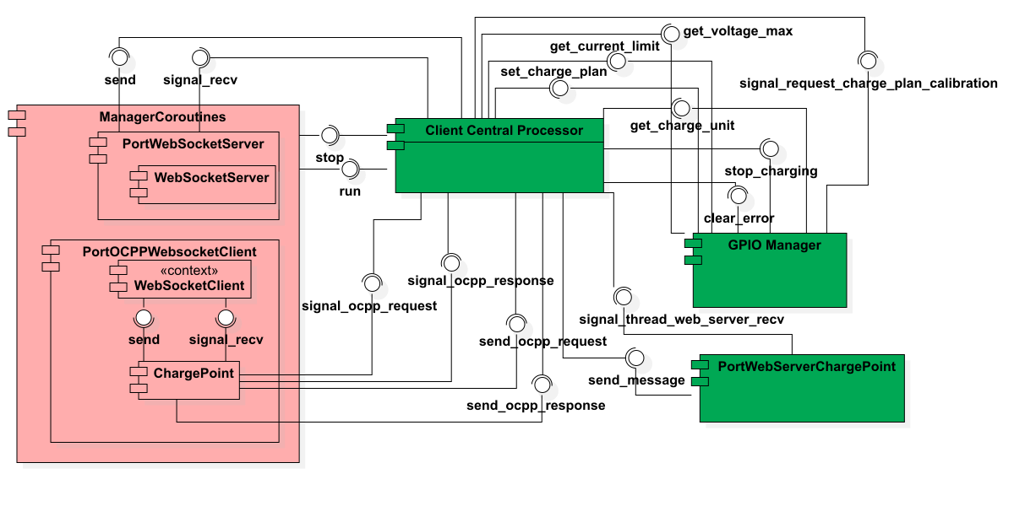
System Architecture
Charge Point
Notes:
This is the internal structure of the charging station. The pink parts are coroutines, and the green parts are threads. All modules connect to the Central Processor, which manages the scheduling.
Next, Yunan will explain the charging logic part.

Slide 15



Charge modes
Direct charging
Manual schedule
Dynamic adjustment
Start
Stop
Buttons on the charge pile or website
Charge according to the uploaded schedule
Start time, power of each section
The schedule is generated by the optimizer according to the user’s needs.
Calibration of the charging plan periodically
Notes:
We have designed 3 charge modes.
Direct charging can literally only control the start and stop of charging, by pressing the buttons on the charge pile or via the website. Then the charge station will charge at the maximum allowed current.
The Manual schedule mode is mainly used for debugging. The charging station will charge according to an uploaded schedule. The charge time point and charge power are defined in this schedule.
The dynamic adjustment mode is the main target of our project. It realizes the smart charging. The schedule is generated by the optimizer according to the user’s needs such as “lowest electric price” or “balanced price and speed”. The charging plan will be calibrated periodically to compensate for the deviation in the charging process, based on the data collected from the shelly sensor.

Slide 16
Detailed charging steps
Plug in the charge plug
Select the charge mode and start
Before charging
In charging
Charging ends
EVSE:
EV is present
Check:
Vehicle,
EVSE,
Shelly, applicable plan
Latch plug
The optimizer generates the charge schedule
Max. current to EVSE
Calibration
Polling-EVSE, Shelly
Unlatch
Clear data
If not
ERROR
Hardware failure
Notes:
The charging stations will perform different actions at different stages of charging.
When the user inserts the charge plug selects the charge mode and presses the start button. The system will check if all the components are working properly, and also check if the plan is applicable, for example, the user wants to fully charge the car in 5 minutes. It will be rejected because the required power is clearly much higher than the power limit.
Anything that shows abnormality in this process will lead to an error, the charging will not start.
If everything is OK, the station will latch the plug, the optimizer will generate the charge schedule.
In the charging process, the output power is controlled by changing the maximum current value in the EVSE register.
The system will periodically calibrate the plan, and get data from the EVSE and the Shelly sensor via polling. If any hardware failure occurs in this process, it will also raise an error and immediately terminate the charging.
After the charging is finished, the charge station will unlatch the charge plug and clear the data stored in Shelly.

Slide 17
Trim of plan – Influence of delay
System response delay
Network delay
Charge
unit 1
1kW
2kW
1kW
2kW
Charge
unit 2
4kW
2kW
delay
4kW
2kW
Charge
unit 3
1kW
2kW
1kW
2kW
Limit
(6kW for example)
8kW
6kW
6kW
6kW
6kW
2kW
1st hour
2nd hour
1st hour
2nd hour
Notes:
In our project, we have considered a lot about the influence of delays.
For example, according to the plan the 3 charge units should charge without violating the limit. However, due to the System response delay and Network delay, the charge schedule of unit 2 arrived later.
Consequently, the total power exceeds the limit for a certain duration. This may cause equipment overload.

Slide 18

Trim of plan
Arrive of New schedule/
Schedule update
Now
New schedule start time is in future
Old schedule
New schedule
Time
Arrive of New schedule/
Schedule update
Now
Old schedule
New schedule after truncation
New schedule
Time
Cut off
New schedule start time already passed
Notes:
To solve this, the system will not directly execute the new schedule.
If the new schedule starts in the future, the system will wait or continue with the old schedule.
If the new schedule start time point is already passed, the system will cut off the expired parts of the schedule, and continue with the rest.

Slide 19
Trim of plan
Before truncation
After truncation
Charge
unit 1
1kW
2kW
1kW
2kW
Charge
unit 2
delay
4kW
2kW
4kW
2kW
Charge
unit 3
1kW
2kW
1kW
2kW
Limit
(6kW for example)
8kW
6kW
6kW
6kW
6kW
2kW
2kW
1st hour
2nd hour
1st hour
2nd hour
Notes:
In this way, this risk is avoided and the deviation will be compensated by the following calibrated schedule.

Slide 20






Optimization considerations
Extend Battery Lifespan
4
1
Predict Charging Demand
2
Optimize Charging Costs
Achieve Grid Load Balancing (V2G)
5
3
Different charging options
Improve User Experience
6
Notes:
In the optimizer part, we considered 6 optimization directions:
1. Predict charging demand through the user's historical electricity usage. In this project, we wrote a function to generate random electricity history usage as one of the input parameters of the optimizer
2. Optimize charging costs based on dynamic electricity prices. In this project, the electricity price is converted into a list as one of the inputs of the optimizer
3. Provide users with different mode options. There are 3 modes: shortest charging time, minimum charging cost and dynamic adjustment
4. Improve battery life. We consider continuing to charge at the minimum current after full charge to extend battery life
5. Use V2G to balance the grid load, but in actual testing, our car does not have hardware support, so it is not used
6. Improve user experience. We hope to develop a mobile app in the future to intelligently recommend charging modes based on user habits, etc.
在优化器部分，我们考虑了6点优化方向：
1，通过用户的历史用电记录来预测充电需求，在本项目中，我们写了一个函数来生成随机的用电历史记录，作为优化器的输入参数之一
2，根据动态电价来优化充电开销，本项目中将电价变为一个列表成为优化器的输入之一
3，提供用户不同的模式选择，有3种模式：最短充电时间，最小充电花销和动态调整
4，提高电池寿命，我们考虑在充满电之后持续以最小电流继续充电来延长电池寿命
5，使用V2G来平衡电网负载，但在实际测试中我们的汽车没有硬件支持，所以没有使用
6，提高用户体验，我们希望后续开发手机app，根据用户习惯来智能推荐充电模式等

Slide 21
Optimization method
Why Use scipy.optimize.minimize for Optimization?
easy to deploy
Pros
Cons
Lacks learning ability
No need for training
Optimization failed
with multiple uncertainties
Fast computational speed
Notes:
After careful consideration, we chose the minimize function in scipy for optimization.
Its biggest advantage is that it is easy to develop and has fast calculation speed.
在经过考虑后，我们选择了scipy中的minimize函数来进行优化，其最大的优点在于容易开发和计算速度快

Slide 22
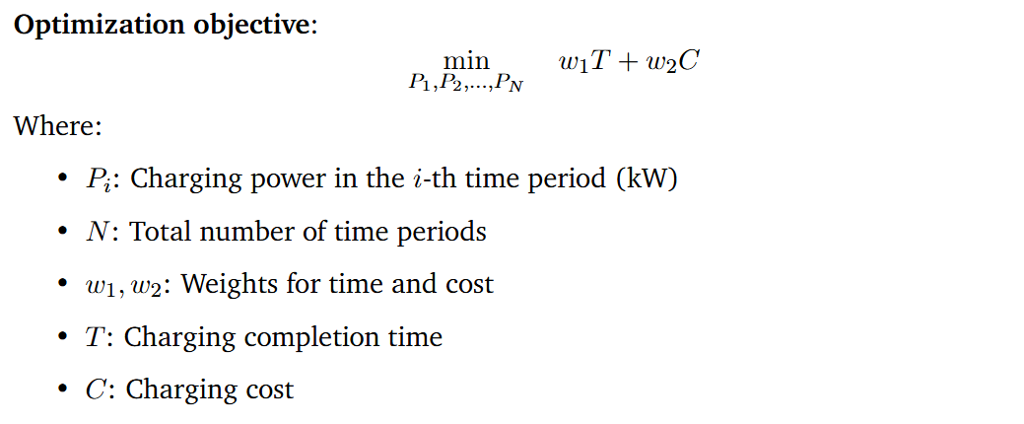
Optimization objective
Notes:
Our final optimization objective function is shown in the figure.
This cost function consists of two parts. T represents the time required to reach the target charging amount, and C represents the total charging cost.
The sum of these two parts multiplied by weights w1 and w2 is our optimization goal.
Other specific parameters are shown in the figure
我们最终的优化目标函数如图，
这个costfunction由两部分组成，T代表了达到目标充电量所需的时间，C代表了总共的充电花销，将这两部分分别乘以权重w1和w2相加便是我们的优化目标，
其他的具体参数如图

Slide 23
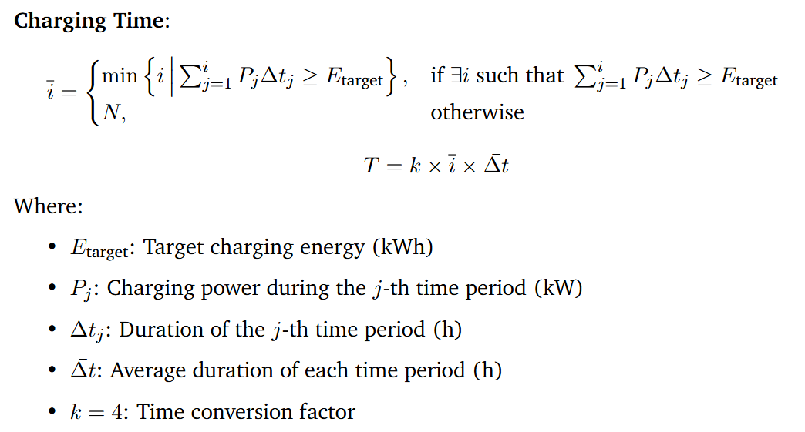
Optimization objective
Notes:
This equation defines how we calculate the charging time required to reach the energy target.
First, we identify the earliest time index i‾\overline{i}i at which the accumulated energy from charging—calculated as the sum of PjΔtjP_j \Delta t_jPj​Δtj​—meets or exceeds the target energy EtargetE_{\text{target}}Etarget​.
If the target is never met, we assume the full schedule is used.
Then, we compute the total charging time Tby multiplying i‾\overline{i}i with the average time step Δtˉ\bar{\Delta t}Δtˉ and a factor k, which adjusts the time units to match our system output—such as converting hours to time slots or cost units.
This approach allows us to evaluate and minimize charging duration as part of the overall optimization.

Slide 24
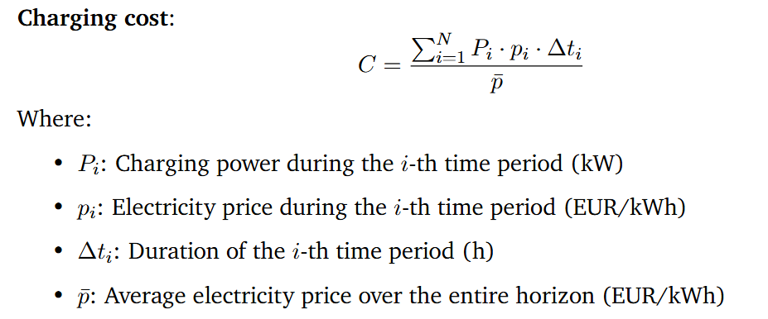
Optimization objective
Notes:
This equation defines the charging cost CCC as a normalized sum of energy consumption over time.
In each time period iii, the cost is calculated as the product of the charging power PiP_iPi​, the electricity price pip_ipi​, and the duration Δti\Delta t_iΔti​.
We then sum this over all time periods and normalize it by the average electricity price pˉ\bar{p}pˉ​.
This normalization allows us to compare cost-effectiveness under different pricing conditions and ensures the cost term is consistent with other terms in the objective function.
By optimizing this term, the system prefers charging during low-price periods while still ensuring the energy demand is met efficiently.

Slide 25


Optimization objective
Notes:
To ensure feasibility and safety, our optimization includes two key constraints.
First, the total charged energy—the sum of Pi⋅ΔtiP_i \cdot \Delta t_iPi​⋅Δti​ over all time periods—must meet or exceed the target energy EtargetE_{\text{target}}Etarget​.
Second, in each time period, the charging power PiP_iPi​ must stay within its allowed range, defined by a minimum and maximum power limit, Pmin⁡,iP_{\min, i}Pmin,i​ and Pmax⁡,iP_{\max, i}Pmax,i​. These bounds can vary depending on hardware limits or grid constraints.
For the initial guess used by the optimizer, we simply set P0P_0P0​ as the average of all maximum powers across the time horizon.
This initialization provides a reasonable starting point for the solver to quickly converge to an efficient solution.

Slide 26
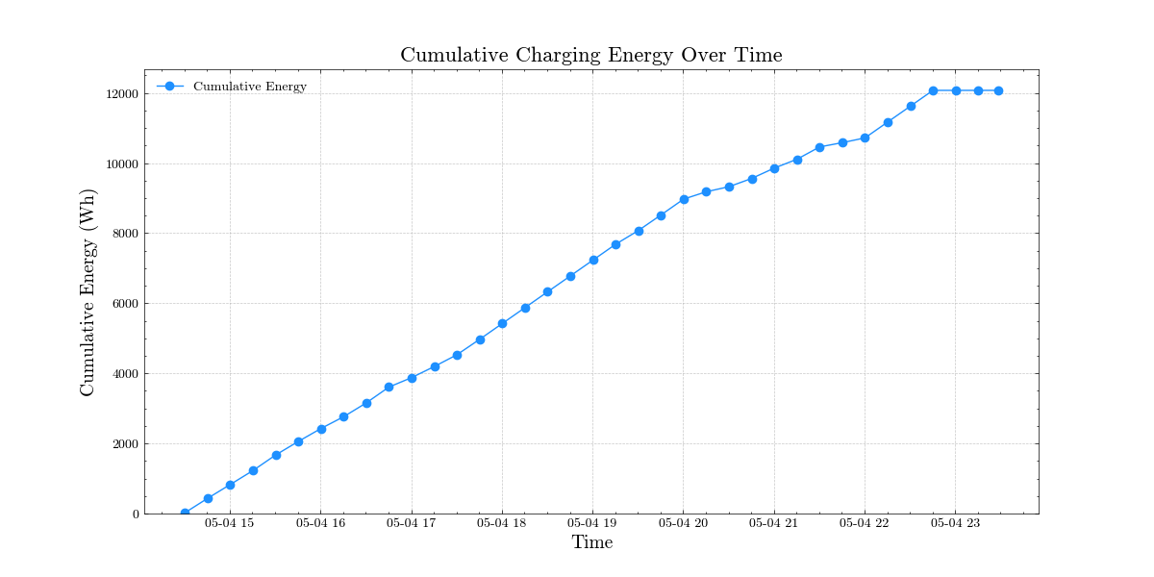
Optimization result
Notes:
This picture shows the charging amount in different modes.
You can see that the functions of different modes are perfectly realized.
这张图片展示了不同模式下的充电量，可以看到完美的实现了不同模式的功能

Slide 27
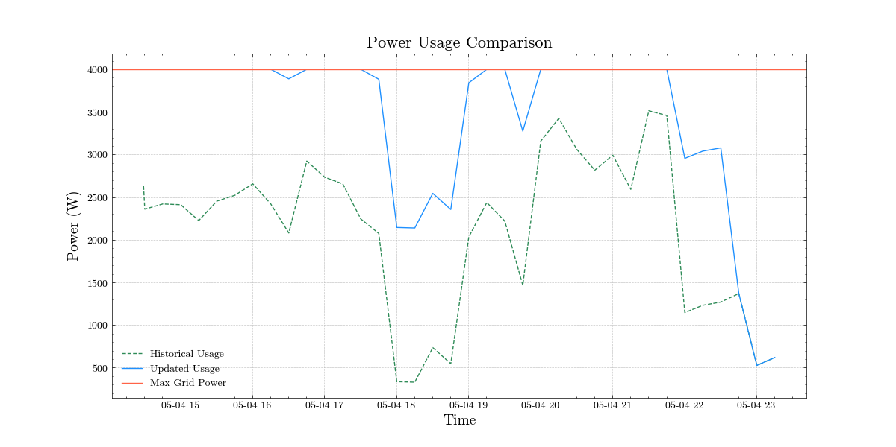
Optimization result
Notes:
This picture shows the user's grid power.
The green line represents the user's historical power consumption when not charging,
the red line represents the maximum power,
and the blue line represents the power load after adding car charging.
It can be seen that the final power does not exceed the maximum power,
and charging stops after reaching the target charging amount.
这张图片展示了用户的电网功率，图中绿线代表未充电时用户的历史用电，红线代表了最大功率，而蓝线表示了加入汽车充电后的用电负载，可以看到最终的功率没有超过最大功率，并且在达到目标充电量之后就停止充电了。

Slide 28
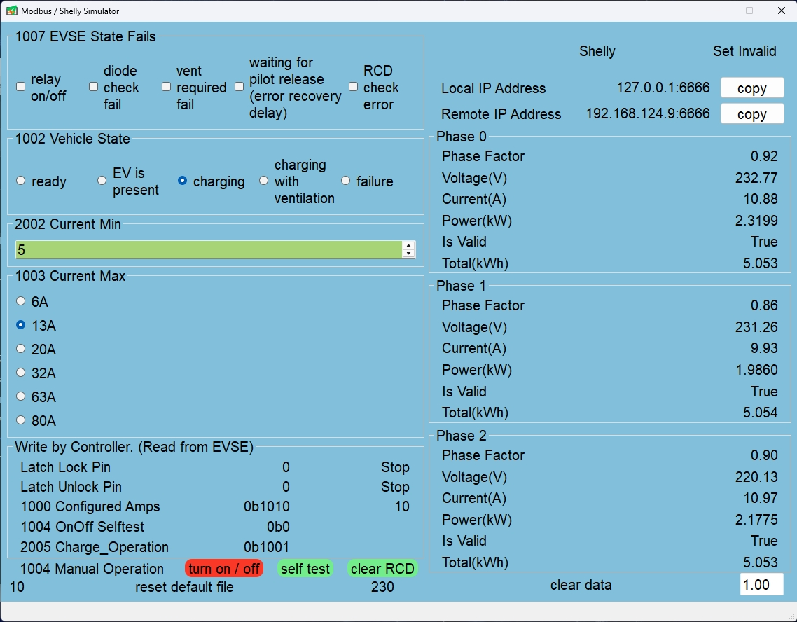
Simulation
EVSE & Shelly Simulator
Notes:
In order to simulate the test without hardware, we wrote a software to simulate the functions of evse and shelly.
It is mainly realized by reading and writing fixed json files and transferring them to the Raspberry Pi.
Later, Chen Huang will talk about things related to testing.
为了在脱离硬件也能模拟测试，我们写了一个软件来模拟evse和shelly的功能。主要是通过读写固定的json文件传输给树莓派来实现。后面由陈煌来讲和测试有关的东西

Slide 29

Problems during Testing
1, No indicator for charge point
Solution:
Always on ready to set current
Fast blinking 0,1s Current is set
Slow blinking 1s Charging
Blinks 2 times Error
2, Modbus port allows only one thread at
one time
Solution: first, serialize access using thread
lock (use context manager to
manage)
then ensure globlally unique
access with singelton pattern
3, Register 1006 “only readable”
Figure 2: Test in lab
Figure 3: Register 1006 status of EVSE from datasheet

Slide 30
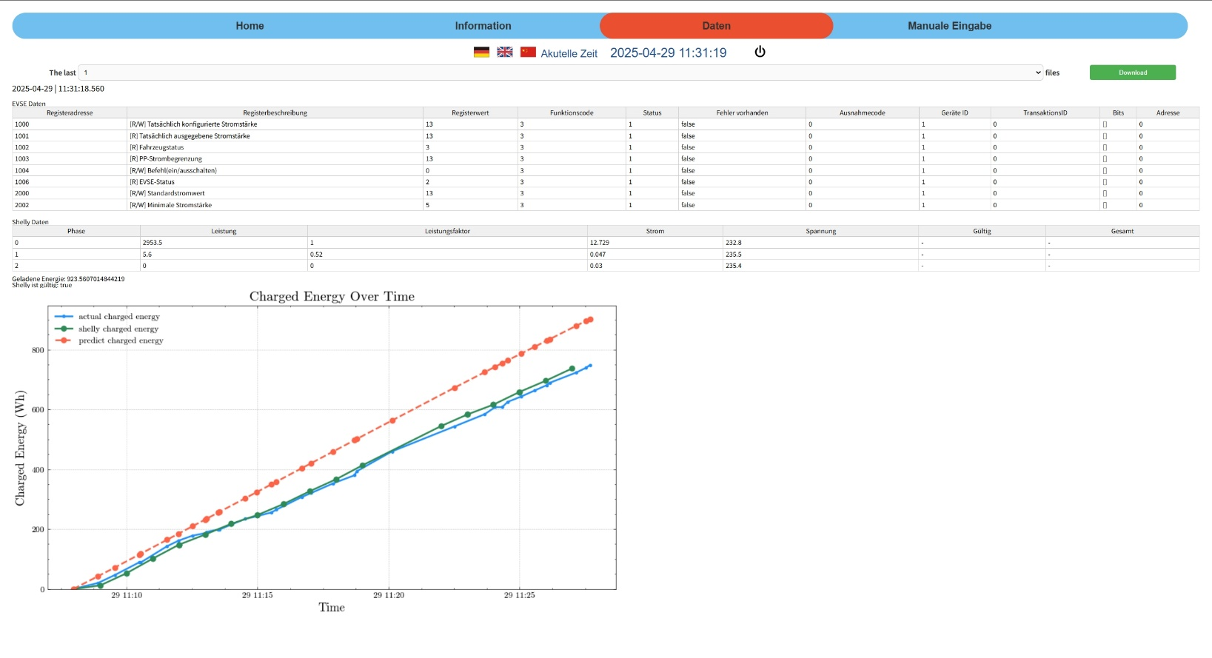
Conclusions
1, Results
1,1 Charging point control and optimization
different modes: directly charging or using charging schedule
1,2 Data visualization
Figure 4: GUI

Slide 31
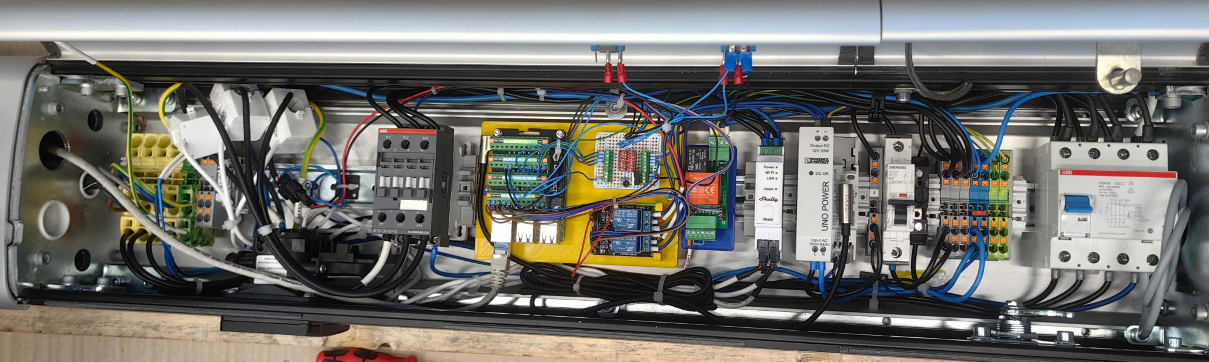
Conclusions
1,3 Communication between charge point and optimizer
1,4 GUI Deign including charging status, log information and control operations
1,5 Simulator Deign
1,6 Hardware modification (Raspberry Pi, Shelly, relay for DC-motor and LED-
indicator)
Figure 5: Hardware connection

Slide 32
Conclusions
2, Discussion
2,1 Compatibility Issues with the OCPP Python Library Versions
2,2 Current Monitoring and Safety Control
2,3 Raspberry Pi Wi-Fi Hotspot Support
2,4 Limitation on Web Terminal Message Display (memory overflow or browser crashes)

Slide 33
Literature
[1] https://www.statista.com/outlook/mmo/electric Electric Vehicles.url:vehicles/worldwide
(visited on 01/2025).
[2] International Renewable Energy Agency(IRENA). Innovation Outlook Smart Charging For Electric Vehicles.Tech. rep. International Renewable Energy Agency(IRENA), 2019

Slide 34

Thank you for the attention.
Question

